Slide 1
Support Vector Machines (SVMs)
Sujay Jakka, Shane Rivera, Amaan Haque, and Michael Moskowitz
COMP 5130 - Data Mining
Undergraduate Final Project

Slide 2
What are SVMs?
Supervised learning models for classification and regression, though mainly binary classification.
Goal is to find optimal hyperplane that best separates data into different classes.
Hyperplane maximizes margin between closest data points of different classes (support vectors).
Use kernel functions to transform data into higher dimensional space where it becomes linearly separate.
Only a subset of training data (support vectors) are used to create the decision boundary.
Can handle high dimensional data and work well with limited samples compared to neural networks.
Could be used for text categorization, image classification, handwriting recognition, and many other purposes.
Notes:
Michael

Slide 3
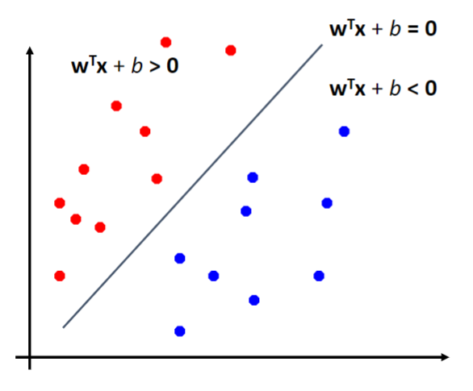

Slide 4
Intuition behind SVMs
The goal is to find optimal hyperplane that best separates data into different classes.
Hyperplane should maximize margin - the distance to closest data points on either side (support vectors).
Only support vectors determine the decision boundary, other points have no effect.
For linearly separable data, hard margin SVM finds widest street between classes.
For non-linearly separable data, soft margin SVM allows some points to be misclassified.
Kernels are used to transform data to higher dimension where it becomes linearly separable.
Solving dual optimization problem gives same hyperplane in terms of inner products (kernel functions).

Slide 5
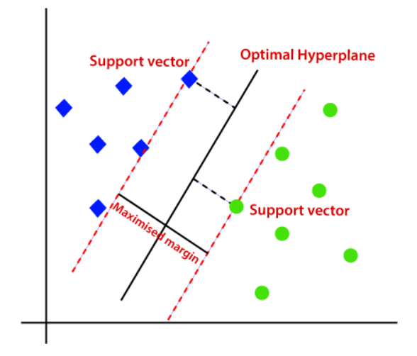

Slide 6
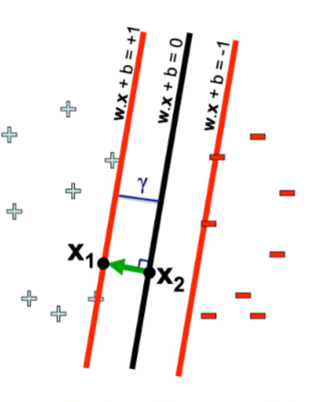

Mathematical Intuition
The distance from either support vector to the decision boundary can be represented as 1 / ||w||. The margin of the SVM is twice this distance, which is represented as ρ = 2 / ||w||.
The points that belong to the -1 class must have a predicted value less than or equal to -ρ/2 and the points that belong to the 1 class need to have a predicted value greater than or equal to ρ/2. This is all before you rescale it by ρ/2. Once you divide your inequality by ρ/2 on both sides, the examples that belong to the -1 class much have a predicted values less than or equal to -1 and the examples that belong to the 1 class must have predicted values of greater than or equal to 1.
Notes:
Sujay

Slide 7
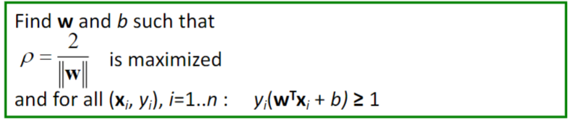
Primal Problem
The goal is to minimize the the magnitude of our weight vector to find as big of a margin as possible separating our two classes while also satisfying the inequalities for each data point.

Slide 8
The Dual Problem
Primal problem: Finds the optimal hyperplane directly in the input space.
Requires solving a quadratic optimization problem with constraints.
Dual problem: Finds the hyperplane indirectly using Lagrange multipliers.
Introduces Lagrange multipliers, α, for each training point.
Solve for α instead of hyperplane parameters directly.
The Dual form is a function expressed in terms of inner products between support vectors.
Only the support vectors have non-zero α values.
Allows using kernel functions to compute inner products in higher dimensional space.
The Dual optimization problem has simpler constraints than the primal problem.
Solving the dual problem gives the same optimal hyperplane as the primal problem.

Slide 9
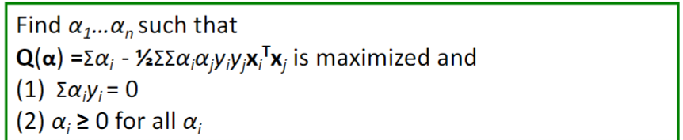
The Dual Problem(Continued)
There is a Lagrange multiplier corresponding to each data point in our dataset. We find the Lagrange multipliers that best satisfies these properties. The two data points that have Lagrange multipliers that are greater than 0 are our support vectors. Once we find the Lagrange multipliers we can easily find our weight vector and bias term.

Slide 10
Difference between a Soft Margin and a Hard Margin SVM
Hard margin SVM is used when data is perfectly separable.
Finds widest margin between classes with no misclassifications allowed.
Soft margin SVM is used when data is not separable or to allow some misclassifications.
Introduces slack variables to allow some data points to be on the wrong side of the margin .
In practice, soft margin SVM is more widely used because it can handle noise and outliers in the training set. In the real world our data will not always be perfectly separable.

Slide 11
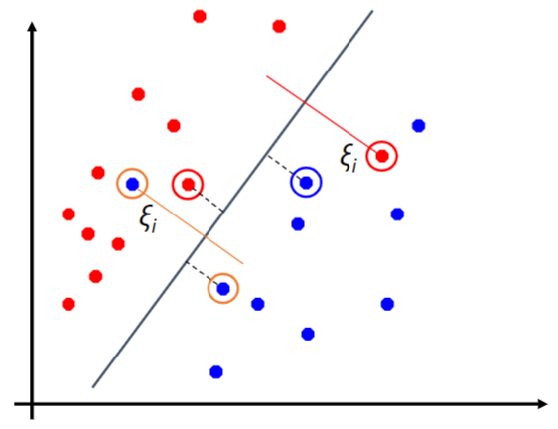

Slide 12
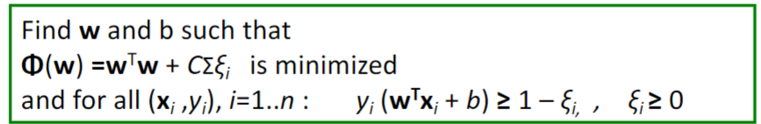
Primal Problem for Soft-Margin SVMs
The primal problem for the Soft-Margin SVM introduces a slack term, ξ, for each data point. These slack terms allow us to be able to create SVMs that allow for misclassification. The C term here is a regularization term that penalizes misclassifications. It determines how much the combined slack across all data points matters to our optimization problem. The larger C is the more we allow it to penalize our function,

Slide 13
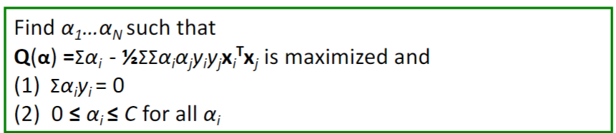
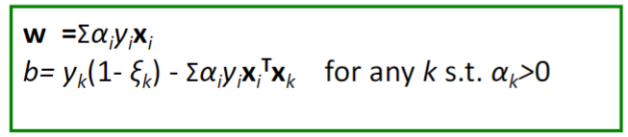
Dual Problem For Soft-Margin SVMs
The Dual Problem is exactly the same as the Dual Problem for Hard Margin SVMs except that there is an additional constraint on our Lagrangian Multipliers. Similar to Hard Margin SVMs the Lagrangian Multipliers have to be greater than or equal to 0 however now the Lagrangian Multipliers also have to be less than or equal to C.

Slide 14
Kernel Functions
Transformation Tool: A kernel function in SVMs transforms the original data into a higher-dimensional space.
By transforming the data, the kernel helps to find a clearer separation between different classes or categories in the dataset.
Kernel’s are useful when the data isn't easily separable linearly in its original form, allowing SVMs to deal with non-linear relationships.
Inner Product Mapper (dot products):
Instead of explicitly computing the coordinates in this higher-dimensional space and then finding the dot products between each of these transformed points, the kernel computes dot products between pairs of data points, and then applies the transformation which is more computationally efficient.
Options: SVMs can utilize various kernel functions
Linear (no transformation), polynomial (raise the data to a power), and radial basis functions (maps the data to an infinite-dimensional space).
Notes:
Shane

Slide 15
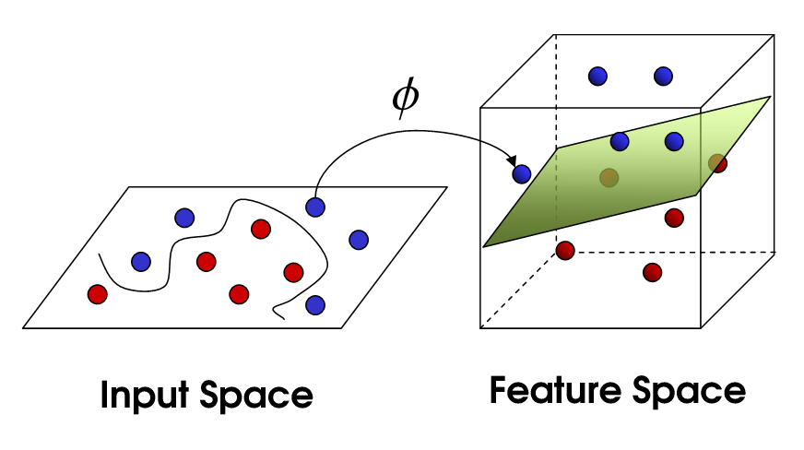

Slide 16
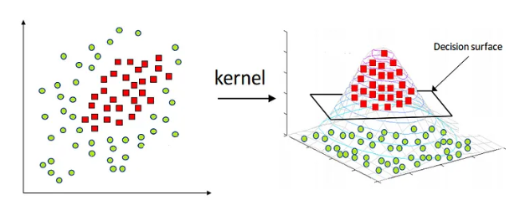

Slide 17
Can SVM’s be used for Multi-Class Classification?
SVMs are not limited to binary classification tasks. They can indeed be extended for multi-class classification problems.
One-Versus-One:
One common approach is to use a "one-versus-one" strategy, where SVMs are trained to distinguish between pairs of classes at a time.
One-Versus-All:
Alternatively, the "one-versus-all" strategy involves training multiple SVMs, each one focusing on distinguishing one class from all other classes.
With both approaches, the final prediction is made by combining the outputs of all SVMs utilized, usually through choosing the class with the highest confidence score(One-Versus-All) and majority voting(One-Versus-One).

Slide 18
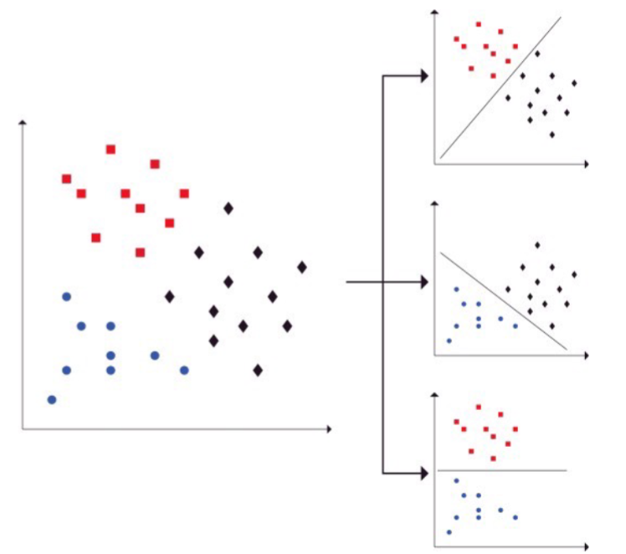
One-Versus-One

Slide 19
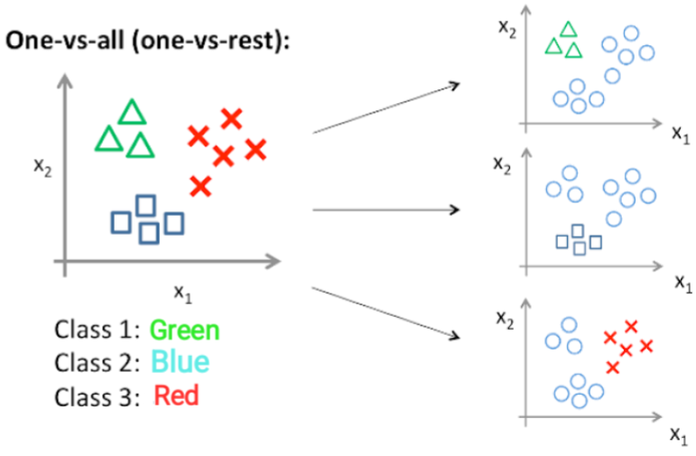
One-Versus-All

Slide 20
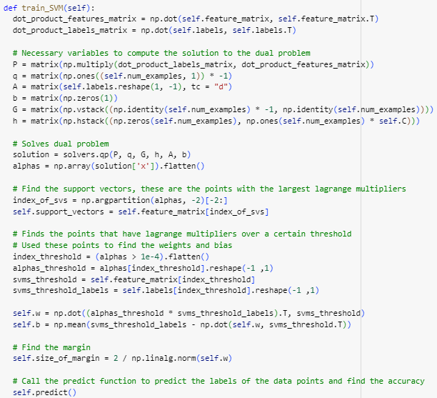

Implementation of finding the Weight Vector and Bias Term
We used the CVXOPT library which is a convex optimization library to solve our dual problem to find the optimal Lagrange Multipliers. Once we found the Lagrange Multipliers, we used these values to find our weight vector and bias term for our SVM.
Notes:
Sujay

Slide 21
The Bananas Quality Dataset
With this dataset, we are trying to predict the quality of bananas to see whether they are Good or Bad.
7 Features
Size, Weight, Sweetness, Softness, Harvest Time, Ripeness, and Acidity.
All of these features are continuous.
Preprocessing: We preprocessed our data by relabeling our class labels, Good and Bad, to 1 and -1 respectively. This will allow our dataset to be compatible with SVMs.
Training Accuracy: 0.86375
Testing Accuracy: 0.87

Slide 22
The Banknote Authentication Dataset
With this dataset, we are trying to predict the authenticity of banknotes whether they are Legitimate or Fraudulent.
4 Features
Variance, Skewness, Curtosis, and Entropy.
All of these features are continuous.
Preprocessing: We preprocessed our data by relabeling our class labels, Legitimate and Fraudulent, to -1 and 1 respectively. This will allow our dataset to be compatible with SVMs.
Training Accuracy: 0.98625
Testing Accuracy: 0.99

Slide 23
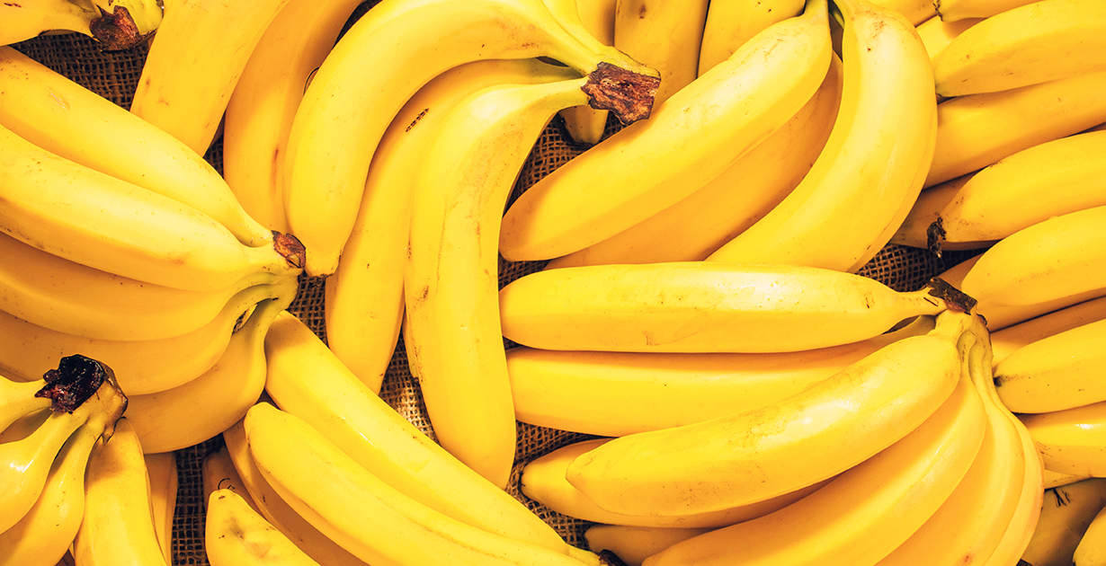
Demonstration
https://www.youtube.com/watch?v=4AA1Ijp_upE

Slide 24
Summary
SVMs are used to find the decision boundary between two classes by finding the optimal hyperplane.
Unlike models that have to be trained iteratively, the decision boundary is found by solving the dual problem.
Hard Margin SVMs are used when the data is clearly separable while Soft Margin SVMs are used to allow misclassifications when the data is noisy.
In the case when are data is not linearly separable, Kernel functions are used to map our data into a higher dimensional plane so we can find a better decision boundary for our data.
SVMs can be used for multi-class classification as well by using the One-Versus-One and One-Versus-All approaches.

